Slide 1

Snapchat filters using opencv
TEAM – PERFECT DEALERS
K.VISHNU SAINADH – AIE19028
K.SATWIK - AIE19034
V.ASHRITH - AIE19066

Slide 2
Aim of the project
Our motivation for this project comes from snapchat and instagram
To build a desktop application to play-around with snapchat alike filters

Slide 3
introduction
Face filters are common applications that we use almost every day in our lives.
We focus on live feed filters as well as image filters
We used OpenCV to complete these filters

Slide 4
Opencv - Open Source Computer Vision Library
Computer Vision and machine learning library
Image processing tool
Multiple languages
It has endless possibilities

Slide 5
Haar cascade
Object Detection Algorithm
Why Haar Cascade ?
Haar Cascade frontal face default
Haar Cascade eye
Haar Cascade nose

Slide 6
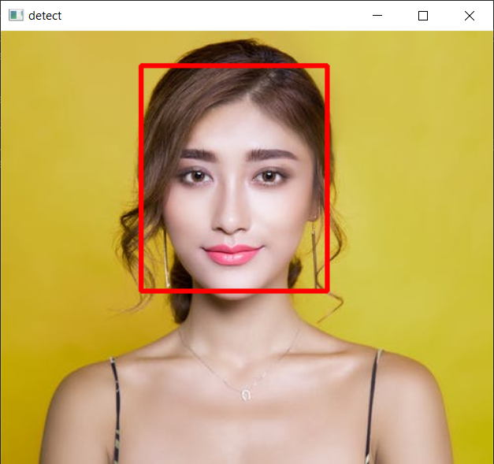
Haar Cascade frontal face default
Used in detecting face
Haarcascade_frontal_face_default.xml returns four parameters - x,y,w,h

Slide 7
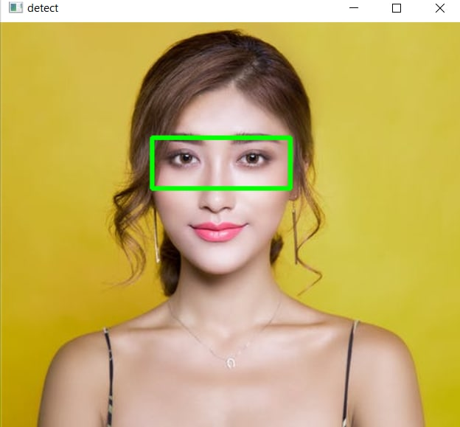
Haar cascade eye
Used in detecting eyes
Haarcascade_eye.xml returns four parameters - ex,ey,ew,eh

Slide 8
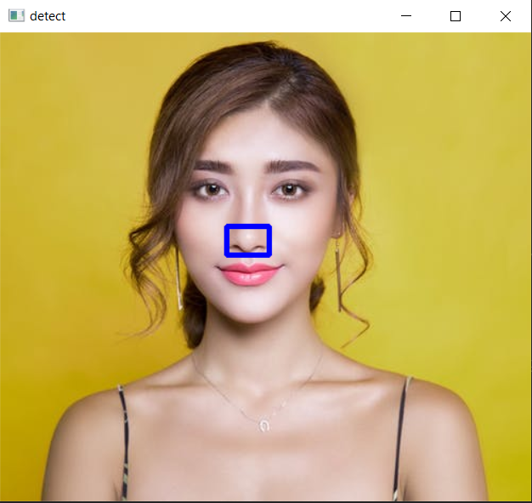
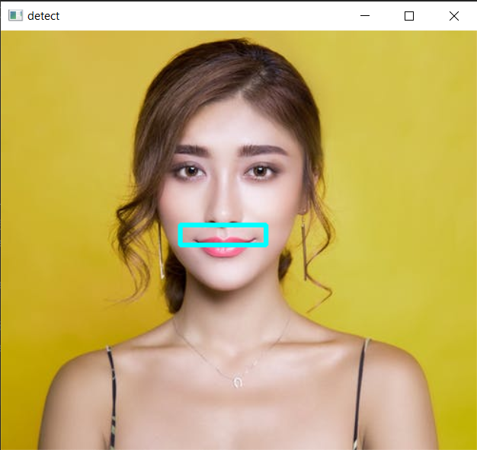
Haar Cascade nose
Used in detecting nose and mustache
Haarcascade_nose.xml returns four parameters - nx,ny,nw,nh

Slide 9
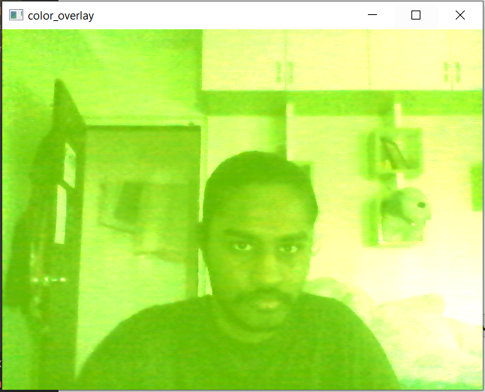
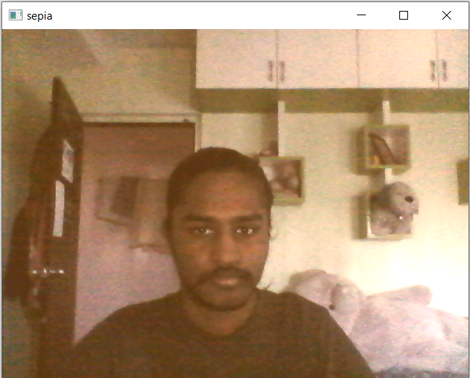
Frame filters
Applies all over the frame

Slide 10

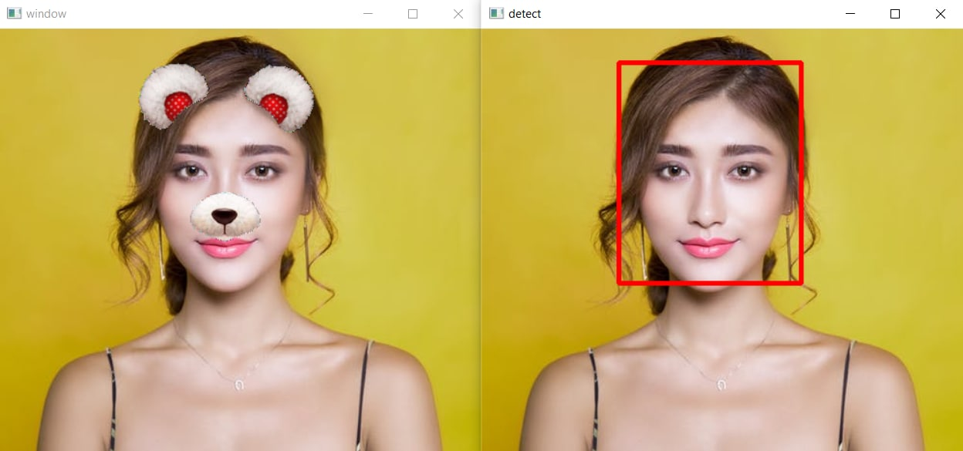
results
eyes
face

Slide 11
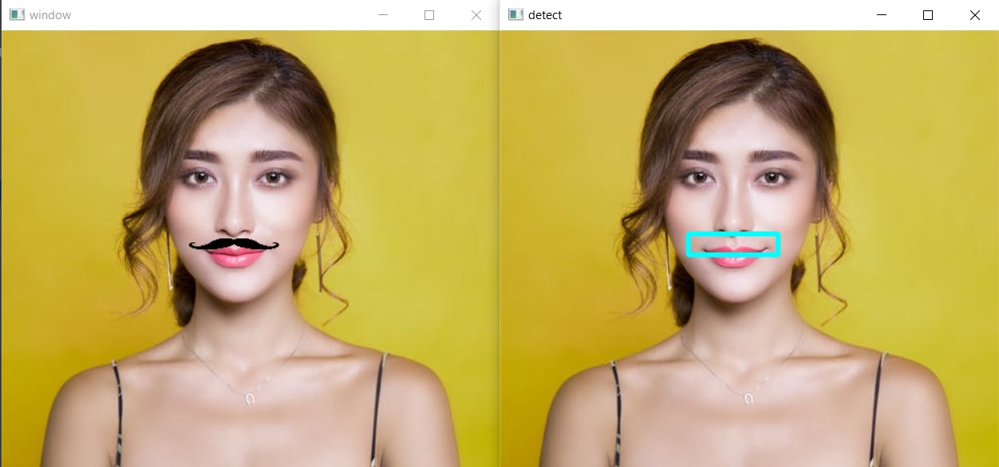
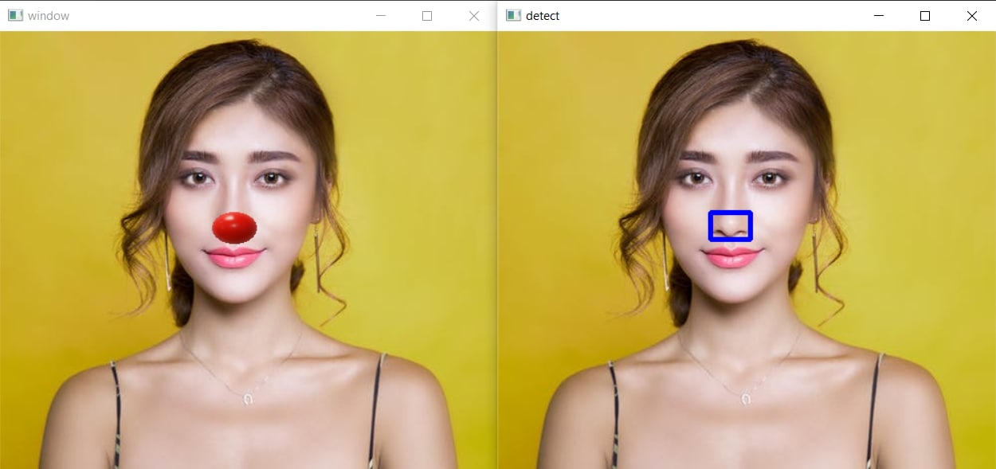
mustache
nose

Slide 12
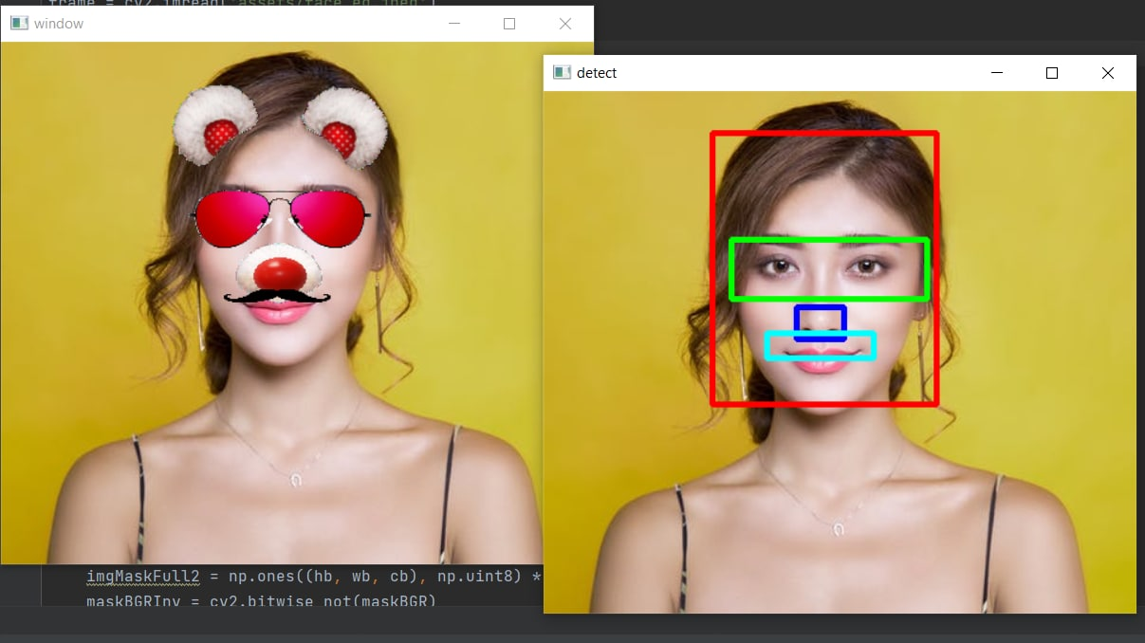

Slide 13
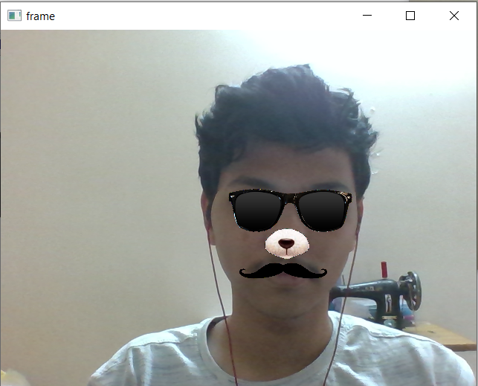
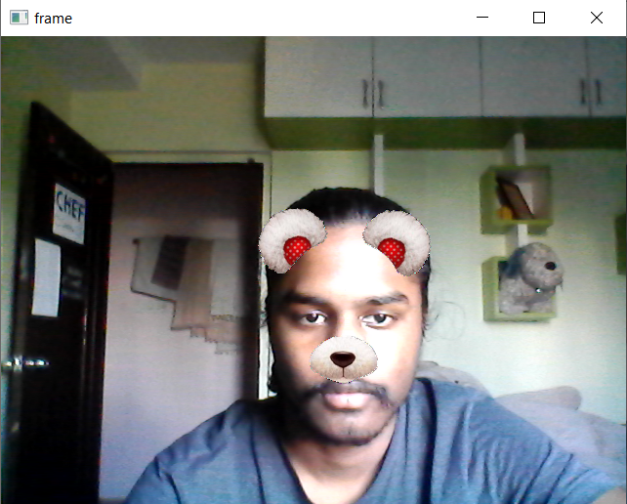
Live feed - result

Slide 14
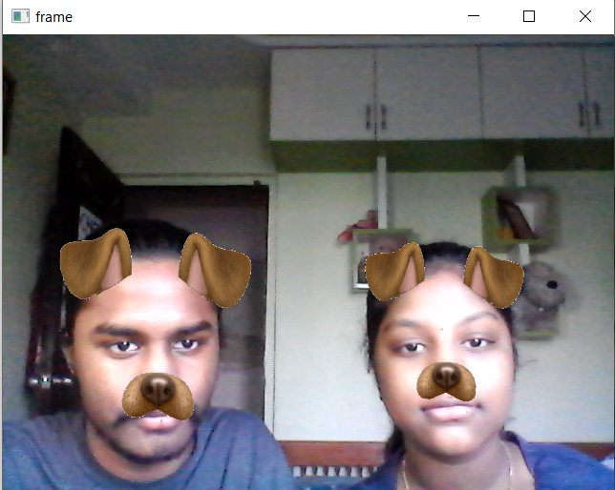
Live feed - result

Slide 15
Let's see our demo

